Slide 1

E-Health Care Facilities
Project By-
Aanchal Oswal
Vachana Shetty
Mustafa Badshah
Rohit Pitre
Project Guide-
Prof. Manali Vashi
Sponsored by -
Persistent Systems Ltd.
Mentor – Mr. Saurabh Vaidya

Slide 2
Outline
Introduction
Motivation
Literature Survey
Current Trends
Problems With Existing Systems
Proposed System
Design
Future Scope
Conclusion
References

Slide 3
Introduction
Don’t we all get frustrated when we miss out on the doctor due to lack of an appointment? How badly does it hamper our work when we lose or damage important medical records? Missing out on a crucial dose of our medicine while we are busy in our work? These our few of the major problems each of us face in our hectic and busy life.

Slide 4
Motivation
High Perception of Value – 79% of Indians believe an E-Health Care Facility system could provide major benefits in managing health.
High Interest – 47% of Indians expressed interest in using an online health care facility.
…BUT only 2.7% have an E-Health Care Facility.

Slide 5
Literature Survey
Paper Name | Author | Algorithm/Methodology | Disease predicted | Limitations/Disadvantages | Various Measures used
Breast cancer diagnosis using machine learning algorithms – A Survey | B.M. Gayathri, C.P.Sumathi and T.Santhanam | Machine learning algorithms- SVM, RVM & Neural Networks | Breast Cancer | SVM is less accurate as it predicts two classes for any given input as compared to RVM and Neural Networks | Accuracy
An amalgam KNN to predict Diabetes Mellitus | NirmalaDevi.M, Appavu Balamurugan, Swathi U.V | Amalgam of K-means and K-NN | Diabetes | It is lazy learner. There is no thumb rule to determine value of parameter k (Number of nearest neighbours). | Accuracy, sensitivity and specificity
Knowledge Discovery in Medical Systems Using Differential Diagnosis, LAMSTAR, and k-NN | Rahul Isola, Rebeck Carvalho, Amiya Kumar Tripathy | K-NN , LAMSTAR | Multiple Diseases | Using Euclidean distance method for classification, increases complexity of algorithm, classification becomes slower. LAMSTAR will assign weights to the examples and according to assigned weights, classification will be done. | Time, Complexity

Slide 6
Paper Name | Author | Algorithm/Methodology | Disease predicted | Limitations/Disadvantages | Various Measures used
Decision Tree Discovery for the Diagnosis of Type II Diabetes | Asma A. AlJarullah | J48 Decision Tree Algorithm & C4.5 | Diabetes | There are other risk factors that the data collection does not consider. Dataset contains data of only female patients. | Accuracy – 78.1768%
Predicting the Analysis of Heart Disease Symptoms Using Medicinal Data Mining Methods | V. Manikantan & S. Latha | K-Mean based MAFIA with ID3 and C4.5 | Heart disease | Prediction of heart attack using patient prescription is not included. | Accuracy – 92% Precision – 0.82
Classification of Heart Disease Using K- Nearest Neighbor and Genetic Algorithm | M.Akhil jabbar, B.L Deekshatulu & Priti Chandra | KNN and genetic algorithm | Heart disease | (KNN+GA) was not successful for breast cancer and primary tumour. As the k value goes on increasing accuracy of data sets is decreasing. | Accuracy – 95.73%

Slide 7
Paper Name | Author | Algorithm/Methodology | Disease predicted | Limitations/Disadvantages | Various Measures used
Two level Diagnosis of Breast Cancer using data mining. | Rajkumar Gaur Grewal, Babita Pandey | J48 classification algorithm | Breast Cancer | J48 is not feasible when larger dataset is used, as small change in dataset reflects in larger modification in decision tree. | Sensitivity 94%-100%
Masses Detection Using SVM Classifier Based on Textures Analysis | Fatima Eddaoudi, Fakhita Regragui, Abdelhak Mahmoudi and Najib Lamouri | SVM classification based on Haralick vector Algorithm developed by S.M. Kwok and R. Chandrasekhar | Breast Cancer | The displacement and the orientation used for the calculation of co-occurrence matrix significantly affect the results. The mixing of two approaches(co-occurrence and contours) just gave satisfactory results | 95% of classification rate can be achieved by using pre-segmented mammograms by maxima thresholding.

Slide 8
Software & Hardware Requirements
Android Developer Tools(ADT)
MySQL Database
PHP
Bootstrap
Backbone
Eclipse IDE
Blue Stacks

Slide 9
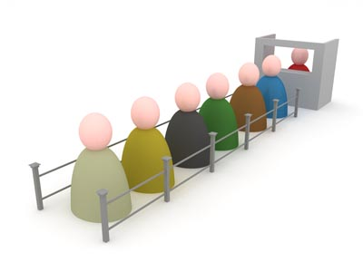
Current Trends
Standing in long queues for taking a doctors appointment
Standalone Personal Health Records

Slide 10
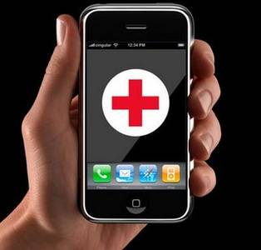
Proposed System
Smart Phone Application
Tethered/Connected Personal Health Records
Take appointments online
Alerts/Reminders for medicines/appointments

Slide 11
System Architecture
User requests for sign up, sign in, doctors appointment, disease prediction.
USER APPLICATION (Android)
Request to server
DATABASE
INTERNET
SERVER
Respond from server
DOCTOR APPLICATION (HTML)
CONTROLLER
Components
VIEW
Screen layout
Style sheets
Output
MODEL
Abstract Classes
DOCTOR APPLICATION (HTML)
HTTP REQUEST
DATABASE
HTTP RESPONSE

Slide 12
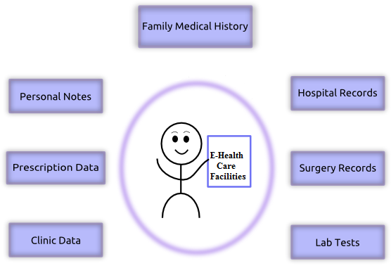
Digital Medical Records

Slide 13

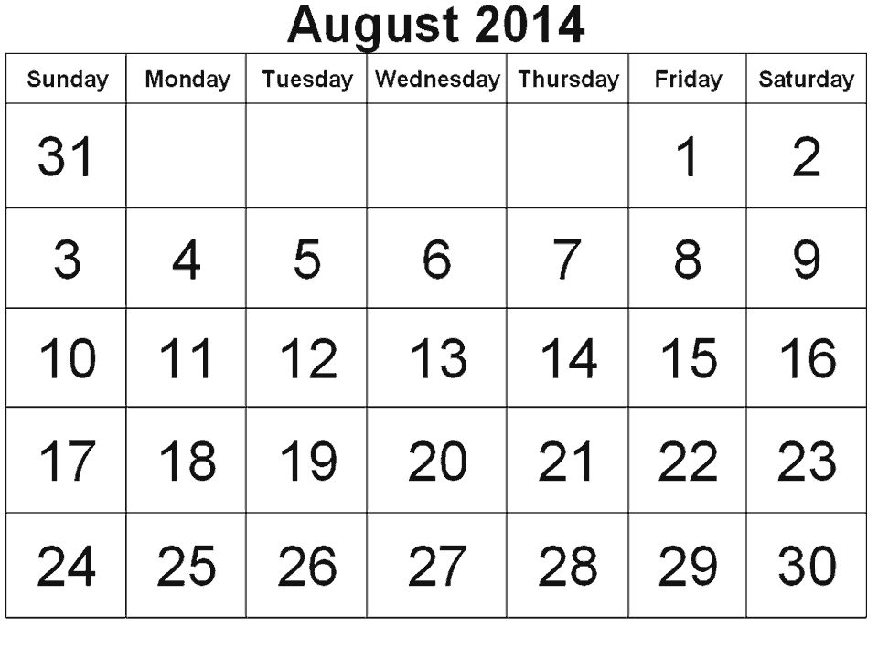

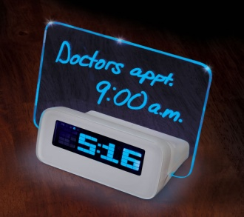
Reminders and Schedules

Slide 14
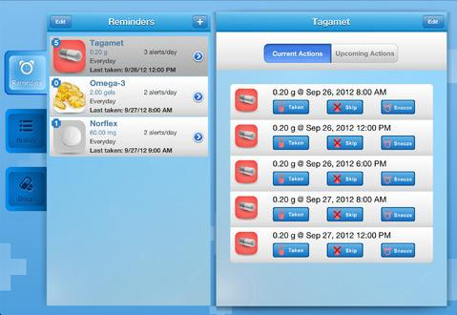

Slide 15
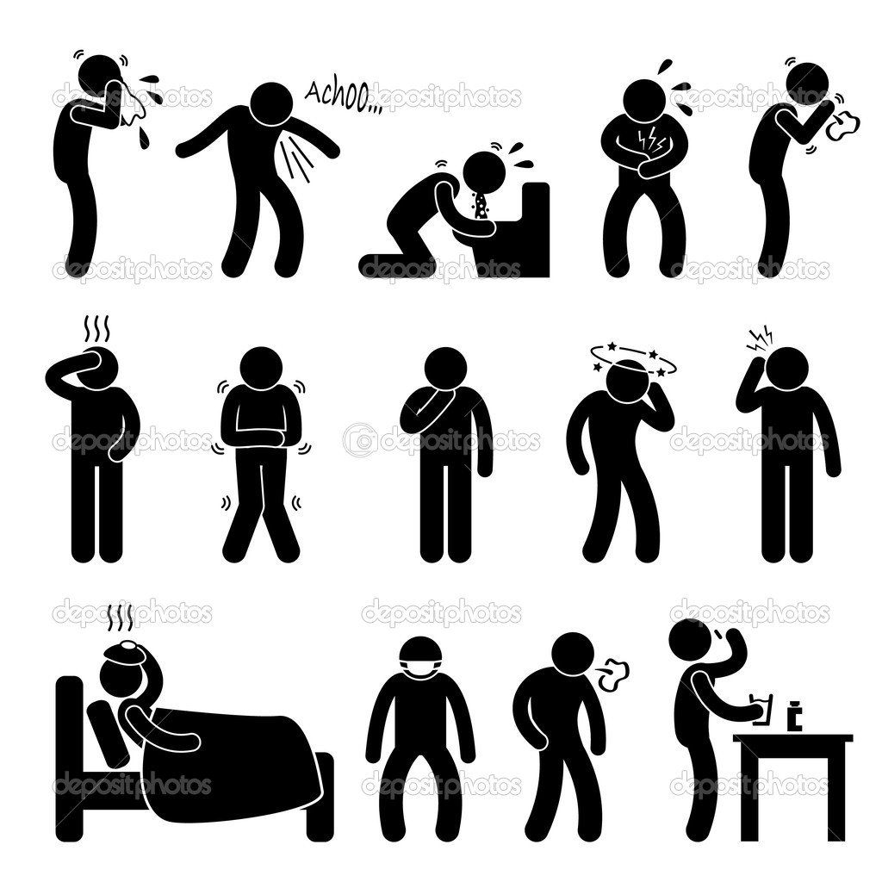
Disease Prediction

Slide 16
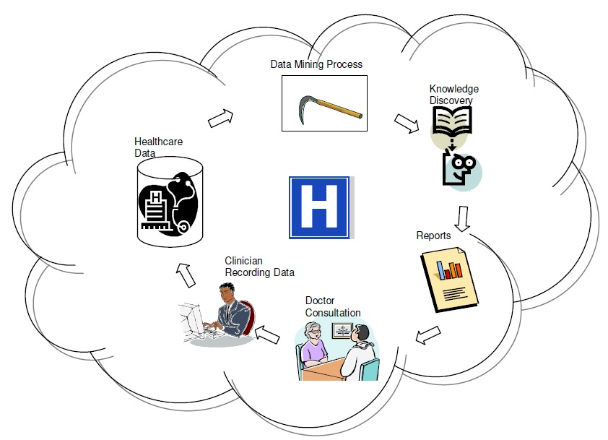
Data mining for Illness Detection

Slide 17
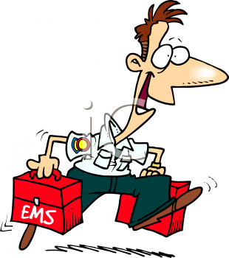


Emergency Services

Slide 18
Future Scope
Our system is scalable and can be implemented globally.
Data mining features can be extended to various other diseases and drug interactions.
Emergency Services can locate us through GPS at times of critical emergencies.

Slide 19
Conclusion
There are various advantages of having such an application and due to the increasing demand of health records, there is an inherent need of such an application.
User-friendly
Less time consuming
Saves Paper

Slide 20
References
An amalgam KNN to predict Diabetes Mellitus, NirmalaDevi.M, Appavu alias Balamurugan.S, Swathi U.V
Asma A. AlJarullah, Decision Tree Discovery for the Diagnosis of Type II Diabetes
Predicting the Analysis of Heart Disease Symptoms Using Medicinal Data Mining Methods
Classification of Heart Disease Using K- Nearest Neighbor and
Genetic Algorithm
Rajkumar Gaur Grewal, Babita Pandey “Two level Diagnosis of Breast Cancer using data mining.”
Masses Detection Using SVM Classifier Based on Textures Analysis by Fatima Eddaoudi, Fakhita Regragui, Abdelhak Mahmoudi and Najib Lamouri.
Knowledge Discovery in Medical Systems Using Differential Diagnosis, LAMSTAR, and k-NN, Rahul Isola, Student Member, IEEE, Rebeck Carvalho, Student Member, IEEE, Amiya Kumar Tripathy, Member, IEEE.

Slide 21
Thank You

Slide 22
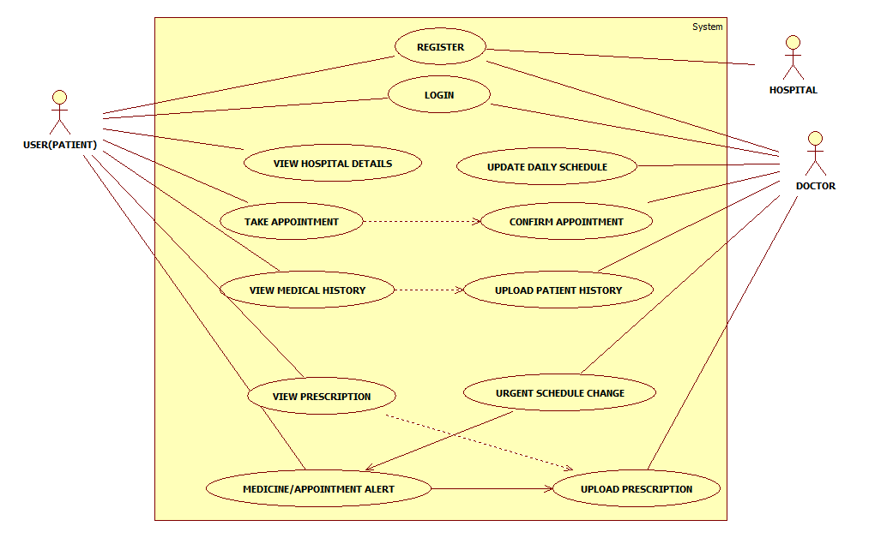
Use Case Diagram

Slide 23
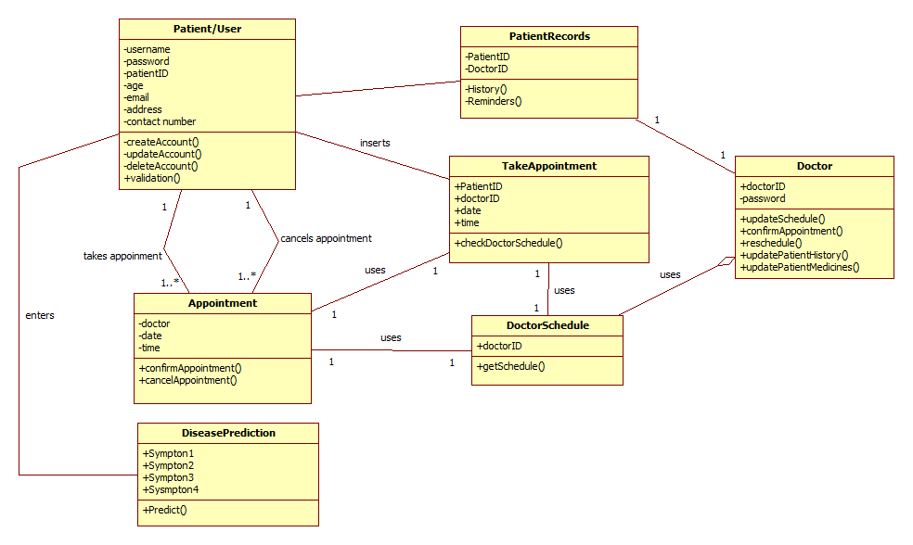
Class Diagram

Slide 24
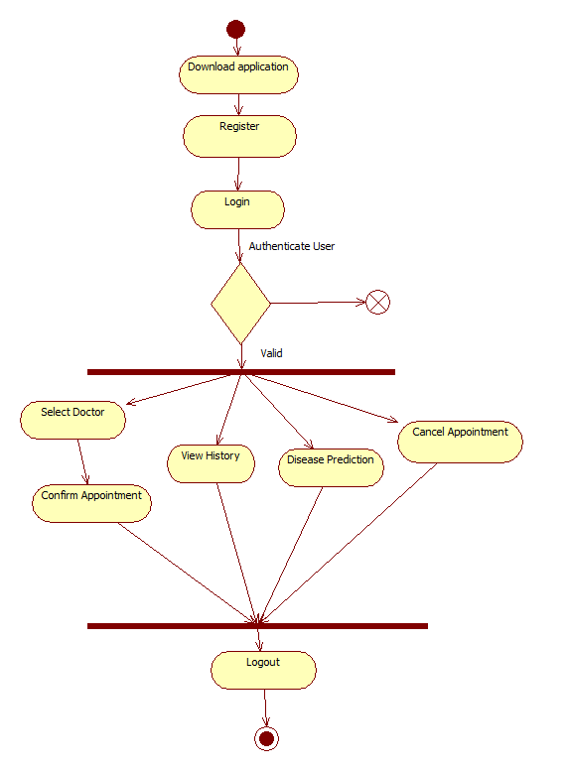
Activity Diagram

